Slide 1


Final Year Project
WanderPlan
Supervised By: Shehzad Ahmad Khan

Slide 2
Project Team
Abdullah Ahtsham (45679)
M. Nabeel Awais (43944)
M. Bilal Butt (44712)

Slide 3
Table of Content
Opportunity & Stakeholders
Solution
Progress Report Summary
Requirements
Software System (Design + Implementation + Testing)
Endeavour (Team + Work + Way of Working)
Next Steps
Prototype / Report

Slide 4
Opportunity & Stakeholders
WanderPlan

Slide 5
Opportunity
The Problem | Travellers are unable to properly plan and manage their trip budgets.
Affects | Tourists.
The result of which | The challenge of creating practical routes. Time lost flipping between several apps for activity costs, accomodation fares and food prices. Inaccurate budget expectations led to a bad trip. Unintentionally, tourists overspend or underspend.
Benefits of | Automatically created spending plan for lodging, travel, and meals. Realistic travel schedules derived from local and real-time data. A clear breakdown of costs to prevent unforeseen costs. Enhanced confidence in planning and financial management.

Slide 6
Opportunity
The Problem | Tourists cannot accurately estimate transportation costs, distances, or directions, especially in unfamiliar cities where prices vary widely.es where prices vary widely.
Affects | Tourists.
The result of which | Transport services overcharge tourists. Unknown distances lead to poor trip planning. Navigating between locations wastes time. Fear and confusion in strange places.
Benefits of | Precise fare and distance estimates prior to travel. Clearly defined routes and options. A visual map of nearby recommendations. Tourists will feel more confident and have safer mobility.

Slide 7
Opportunity
The Problem | Existing review platforms often contain outdated, fake, or paid reviews, making it difficult to trust community feedbacks where prices vary widely.
Affects | Tourists, Business Owners.
The result of which | Inaccurate reviews cause tourists to make bad choices. It is difficult for businesses to gain the trust of real customers. There are few options for reporting, filtering, and engaging with reviews.
Benefits of | An open and interactive review feed. Local donors who make significant reviews are rewarded. Gamification promotes involvement. Companies can improve trust by responding to reviews.

Slide 8
Opportunity
The Problem | Many restaurants, hotels, and nearby attractions don't have the digital presence or resources necessary to advertise sales, reply to reviews, or track consumer interaction.
Affects | Business Owners.
The result of which | Inaccurate reviews cause tourists to make bad choices. Businesses rely solely on walk-in clients. There are no tools to advertise sales to specific audiences. No analytics to identify patterns or visitor behaviour. Insufficient customer communication.
Benefits of | A specific business dashboard for managing profiles. The capacity to post sponsored listings, deals, and advertisements. Perceptive data derived from user visits and review patterns. Increased visibility and interaction with visitors.

Slide 9
Stakeholders
Tourists.
Business Owners.
Admin.

Slide 10
Solution
1. Smart Trip & Budget Management:
Personalized Budgeting: A dynamic engine that intelligently allocates spending for lodging, travel, and food based on the user's total budget.
Integrated Maps: Real-time navigation combined with cost estimation for travel distances.
2. Discovery & Community:
Intelligent Recommendations: Suggests authentic local spots and hidden gems based on real-time trends and user budgets.
Community-Driven Reviews: A contributor ecosystem where users share verified reviews and photos to earn rewards (Gamification).
3. Business Ecosystem:
Business Dashboard: A dedicated web portal for vendors to manage profiles, analyze customer traffic, and post real-time deals.
Unified Platform: Consolidates fragmented tools (maps, budgeting, reviews) into one seamless application.

Slide 11
PROGRESS REPORT Summary
WanderPlan

Slide 12
Requirements
Elicitation Techniques / Tools
Interviews: Conducted with travelers and business owners to identify pain points like budget management and visibility.
Observation: Analyzed how tourists interact with current fragmented platforms.
Brainstorming: Team sessions to merge feedback into structured requirements.

Slide 13
Requirements
Specification / Documentation
1. SRS: Requirements formally documented in the FYP Report using Microsoft Word following SRS (Software Requirements Specification) standards.
2. The SRS outlines functional and non-functional
requirements, ensuring clarity, consistency, and a solid
foundation for system development.
Introduction 5. Implementation
Literature and market survey
Requirement
System Design

Slide 14
Requirements
Users:
Tourists.
Business Owners.
Admin.
Use Cases:
Our system consists of a total of 40 use cases, core use cases are Create Trip, Input Budget, Generate Plan, Register Business, Moderate Reviews.

Slide 15
Requirements
Functional Requirements:
The system includes 64 functional requirements, major requirements are of Dashboard, Trip & Budget Management, Recommendations, Maps, Reviews, Registration, Deals Management, Analytics Dashboard, Business Verification, Content Moderation, System Analytics.

Slide 16
Requirements
Non-Functional Requirements:
The system specifies a set of non-functional requirements that would ensure its quality and reliability in the end. Among these requirements are Performance, which is concerned with fast loading of pages, quick API responses, and instant recommendation results, Reliability, which guarantees high system availability and very low downtime.

Slide 17
Design
Deployment Architecture
Client (Web Browser - Business/Admin, Mobile Application- Tourist).
Application Server (Node.js / Express REST API).
Database Server (Mongo DB).
UML Diagrams Used
Use Case Diagrams.
Activity Diagrams.
Database Schema Design.

Slide 18
Implementation
Development Tools & Technologies
Frontend: React.js, React Native.
Backend: Node.js with Express (RESTful APIs).
Database: MongoDB.
Best Practices / Coding Standards
Modular code structure for maintainability.
MVC-based architecture on the server side.
Git for version control and collaborative development.

Slide 19
Testing
For system validation, we used a Black Box Testing approach, which depended entirely on functional requirements and did not take into account the inner workings of the system. To perform the verification of the system, we created structured test cases that embraced both normal and alternative flows, employing Equivalence Class Partitioning (ECP) for managing both valid and invalid inputs.
The testing gave us the confidence that the system would always respond consistently and act rightly at the tested condition.

Slide 20
Testing
User Sign In (Black Box Testing)
Scenario | Flow
Scenario 1 | Basic Flow – user Signs In with valid credentials.
Scenario 2 | Alternative Flow – incorrect password.
Scenario 3 | Alternative Flow – unregistered email.
Scenario 4 | Alternative Flow – empty fields.

Slide 21
Testing
Inputs, Valid & Invalid Classes (ECP) - User Sign In.
Input | Valid Class | Invalid Class
Email | Registered email in proper format. | Non-registered email; invalid format; empty.
Password | Correct password. | Incorrect password; empty.

Slide 22
Testing
Test Case Design - User Sign In.
Test Case ID | Scenario | Email | Password | Expected Outcome
TC_SI_01 | Scenario 1 | user@example.com | ValidPass121 | User successfully logs in and accesses dashboard
TC_SI_02 | Scenario 2 | user@example.com | WrongPass222 | Error: Invalid credentials
TC_SI_03 | Scenario 3 | unknown@example.com | ValidPass125 | Error: Email not found.
TC_SI_04 | Scenario 4 | - | - | Error: fields cannot be empty.

Slide 23
Endeavour
WanderPlan

Slide 24
Endeavour
Roles of our team members
Abdullah Ahtsham - Documentation, UI/UX & Wireframes, Testing.
M. Nabeel Awais - Mobile Application, Backend Server & Database.
M. Bilal Butt - Business Panel, Admin Panel.

Slide 25
Endeavour
Software Development Process
Development Model
For WanderPlan, we adopted an iterative and incremental development model inspired by Agile practices, which allowed us to break the project into short, manageable cycles. This approach enabled us to prioritize core features like authentication and reviews and the front end development of majority of our project first, ensuring a functional system existed at every stage.

Slide 26
Endeavour
Way of Working as a Team
Skill-Based Allocation: Tasks were divided by technical domain—Mobile App, Web Panels, and Documentation—allowing each member to take full ownership of their specific modules.
Centralized Version Control: We utilized GitHub Desktop to manage our codebase, enabling simultaneous development of frontend and backend features while ensuring version history and code integrity.
Agile Coordination: The team adopted short development cycles with frequent sync-ups to align the integration of mobile and web components and resolve technical issues.

Slide 27
NEXT STEPS
WanderPlan

Slide 28
Work Breakdown Structure (List of all Deliverables / Strikethrough Completed Deliverables)
Reports/Documentation
Make Use Cases, Fully Dressed Use Cases
Make Architecture, Deployment Diagram
Activity Diagram.
Development Environment
React Native, React.js, Node.js.
APIs.
GitHub.
Frontend Development
Mobile App Homepage, Trip Planner Page, Map Navigation Page, Reviews Page, Profile Page, Settings page.
Admin Panel Dashboard, Users page, Business Owners page, Reviews page, Analytics page, Gamification page, Reports page,Settings page.
Business Owner Panel Dashboard,Profile page, Ad Deals page, Review page, POS Integration, Settings page.

Slide 29
Work Breakdown Structure (List of all Deliverables / Strikethrough Completed Deliverables)
Backend Development
Reviews, otpRouter, sendVerification api, Login, MobileApp Auth, BusinessAuth, AdminAuth, Business Approval.
Profile management, Integration of Budget Management,map apis,
Bussiness panel, Admin panel.

Slide 30
Challenges
Time Management
Handling multiple tasks while staying on track with strict deadlines.
Organizing and aligning team efforts to ensure milestones are achieved on time.
Version Control (GitHub & GitHub Desktop)
Keeping code uniform and stable across different branches.
Dealing with regular merges while resolving conflicts efficiently.
Managing the fast-paced process of making sure integration runs smoothly on every team member’s system.
3. Resource Limitations & API Optimization
Accessing premium mapping services (like Google Distance Matrix) was restricted due to high costs.

Slide 31
Prototype & Report
WanderPlan

Slide 32
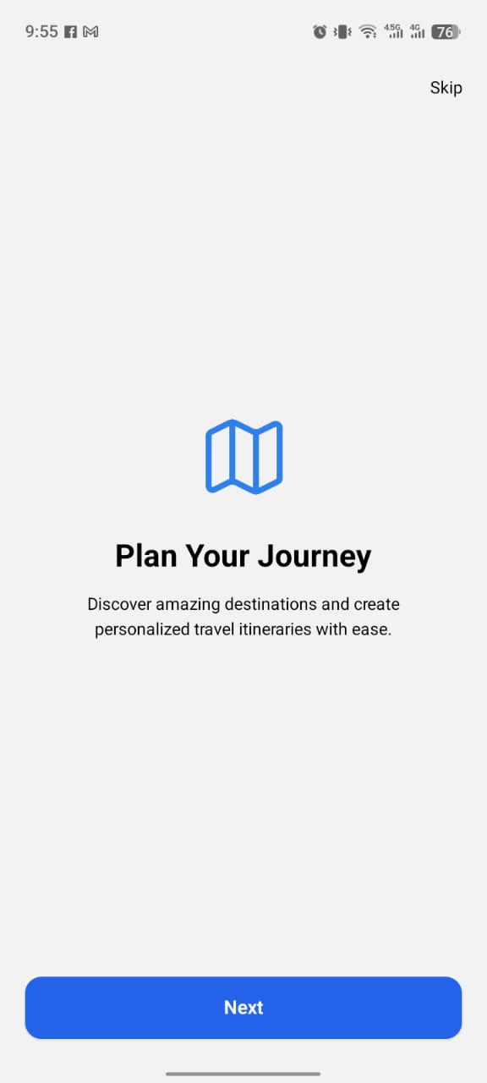
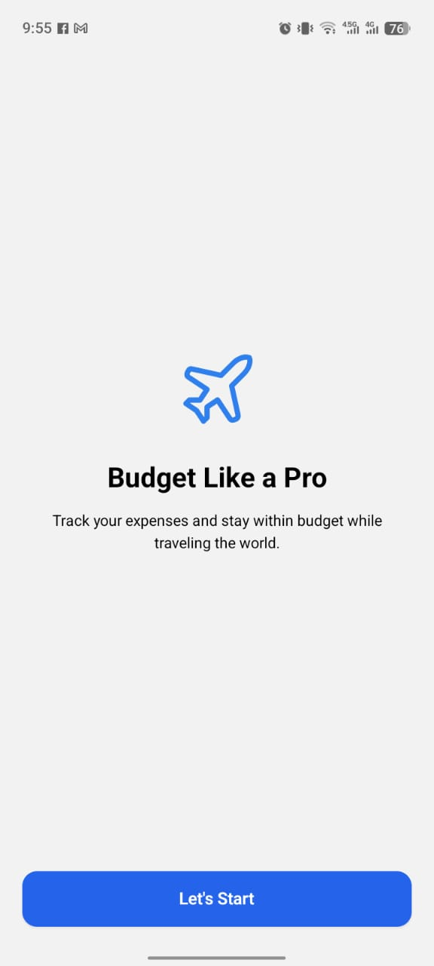
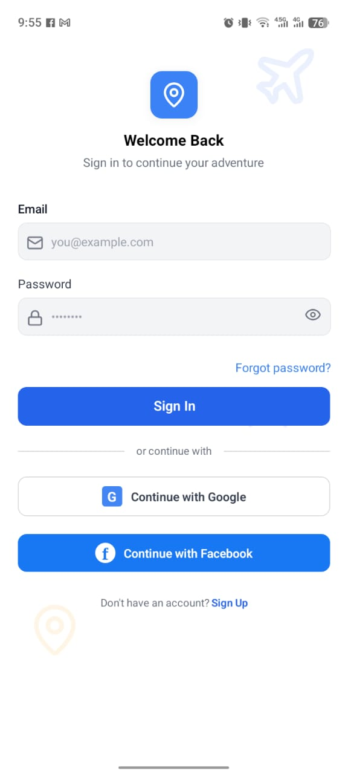
Prototype
Mobile Application:

Slide 33
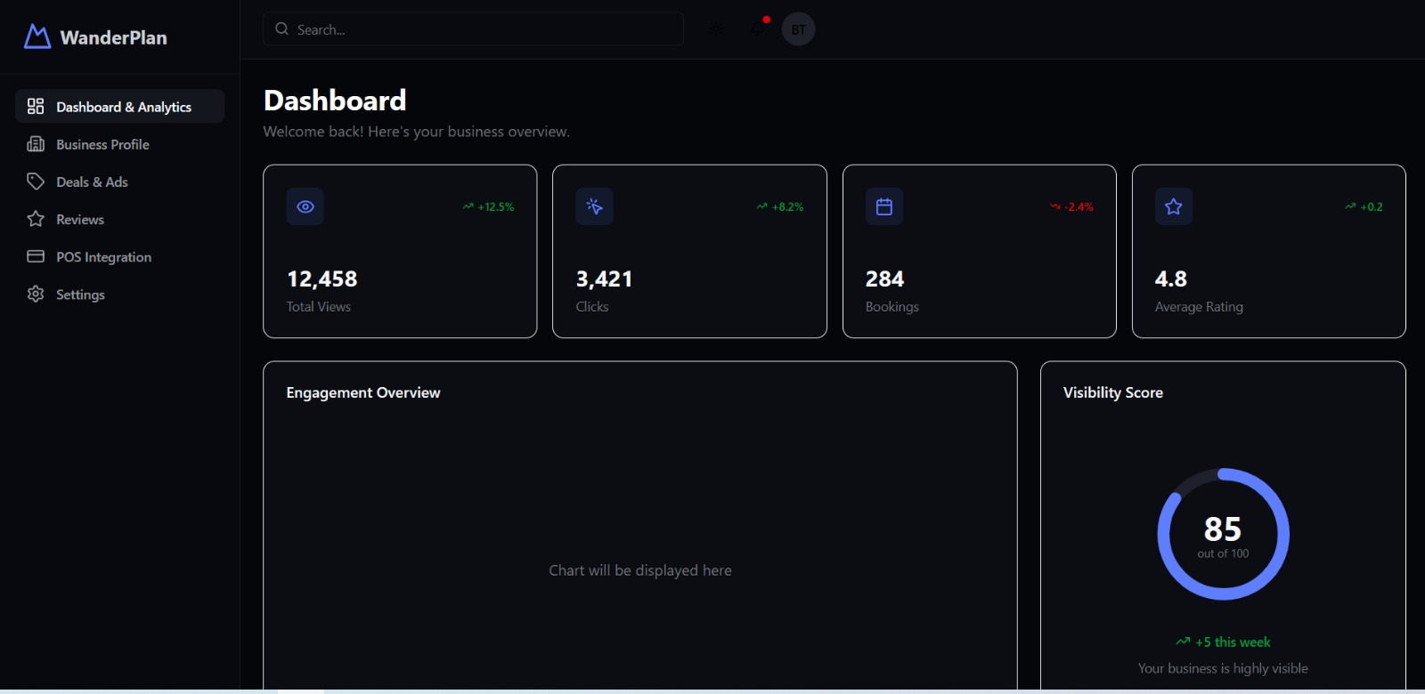
Prototype
Business Web Panel:

Slide 34
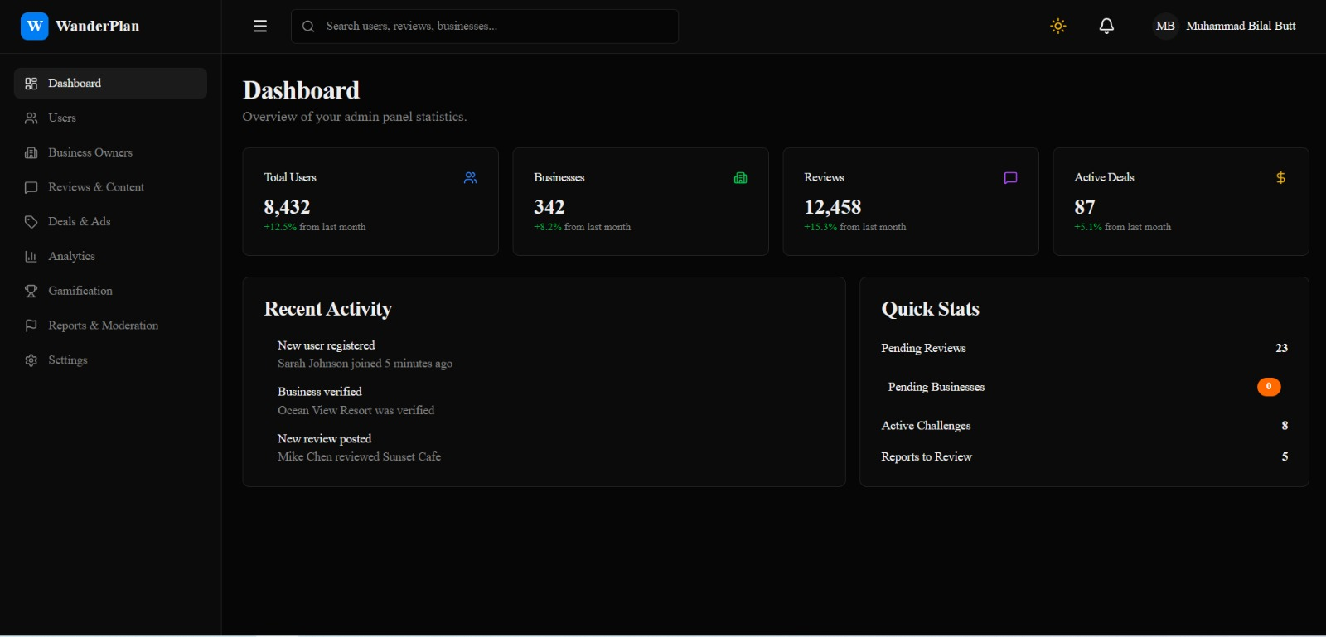
Prototype
Admin Web Panel:

Slide 35
Report
Chapter 1: Introduction (Completed).
Chapter 2: Literature / Market Survey (Completed).
Chapter 3: Requirement Analysis (Completed).
Chapter 4: System Design (Completed).
Chapter 5: Implementation (Completed).
Chapter 6: Testing & Evaluations (Planned for Part-II).
Chapter 7: Conclusion & Outlook (Planned for Part-II).

